Slide 1
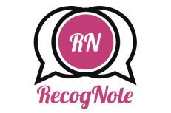
A collaborative effort by The ZyroDev Team

Slide 2
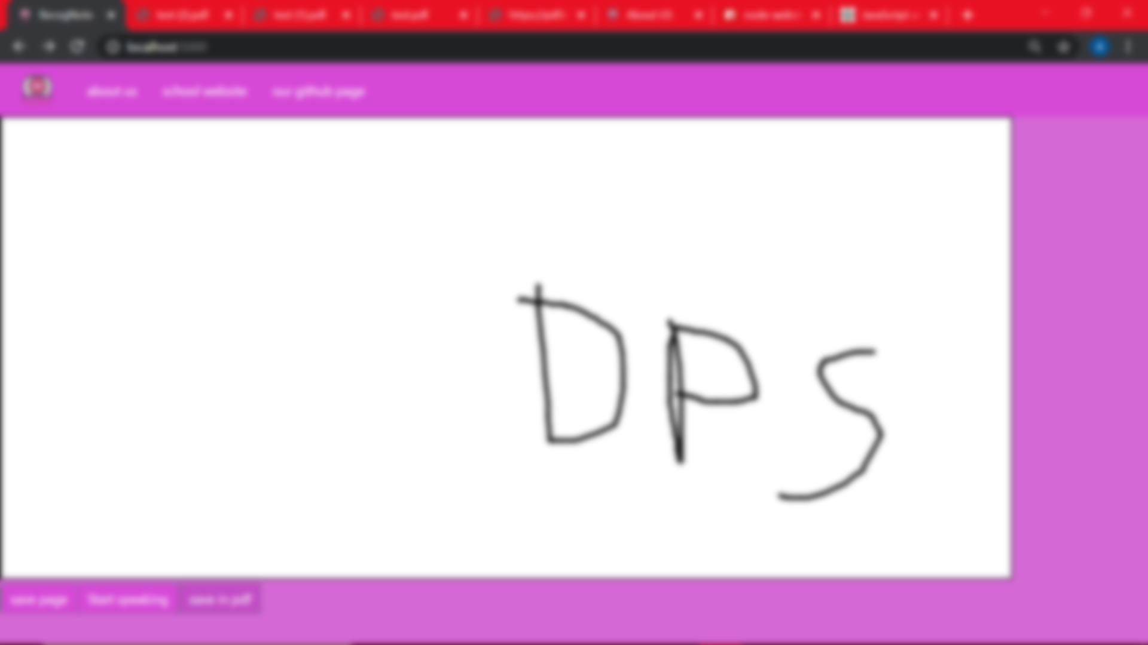
RecogNote –
A Unified solution for the improvement of Information Retention

Slide 3
What is RecogNote?
RecogNote is a software utilising an open-source API to convert real-time speech into a written transcript, as well as allowing for conversion of drawn figures and notes into a readable-and-printable PDF format along with the text transcript.
What RecogNote does is that it converts most languages into a ready-to-read and share text format, and provides additional features such as the ability to save drawn figures/notes into a PDF format file, allowing for it to be printed by students or teachers alike if needed.

Slide 4
Why you want to use RecogNote -
The real-time conversion of speech to text helps students devote more time to their learning instead of having to spend several minutes in taking down notes, saving up to almost 50% of their time spent in class, and allows teachers to spend more time effectively teaching students.
Conversion of Hand-drawn notes as well as the text transcript into a printable PDF format provides a Hassle-Free printing experience as no additional applications are needed to print or download said notes after their conversion.

Slide 5
What makes RecogNote different from its competitors? -
Firstly, RecogNote chiefly separates itself from its nearest competitors by being an app that integrates both the feature of real-time speech to text conversion with the ability to convert drawn figures/notes into PDF files for a unified and simple way to retain information without using multiple applications.
RecogNote also offers a friendly UI for easy accessibility, and is relatively straightforward, with few competing apps(namely Microsoft’s) coming close to its simplistic format.

Slide 6
Questions and our answers to them -
Q: Who all can benefit from this app?
A: Both Students and Teachers can benefit from our software, alongside the environment as well!
Q: Why was this app created?
A: To make note referral easier and more accessible to both students and teachers(and also because we were too lazy to take notes)
Q: Will this replace teachers?
A: A very high probability that it won’t, since it’s simply an efficient note-taking app

Slide 7
Some closing words from our Developers –
First, I’d like to dedicate this one line to my team, without which I wouldn’t have been able to completely showcase this.
Now, onto why I developed this app. This had first started out like this – as an idea for finding a solution to a problem we had experienced before, but had little knowledge of how to solve it. The problem of taking down notes is something that one faces at least once in their educational life, so we wanted to make something that would both solve that, and make the process more unified. So far, this has been my most ambitious project, although reality has limited some of those ambitions. However, I am sure that you, the consumer, will find this satisfactory.
- A.M (A.K.A Zyroknight)

Slide 8
Thank you for your time.
Your support is appreciated.
If you liked this product, consider following our other projects as well!

